Slide 1
Unit 1 - Lesson 01
Objectif:
Savoir parler de ses émotions, dire comment on se sent

Slide 2
Let’s Speak !
What’s your name?
My name is …

Slide 3
Let’s Speak !
How old are you?
I’m 13 14 15 16

Slide 4
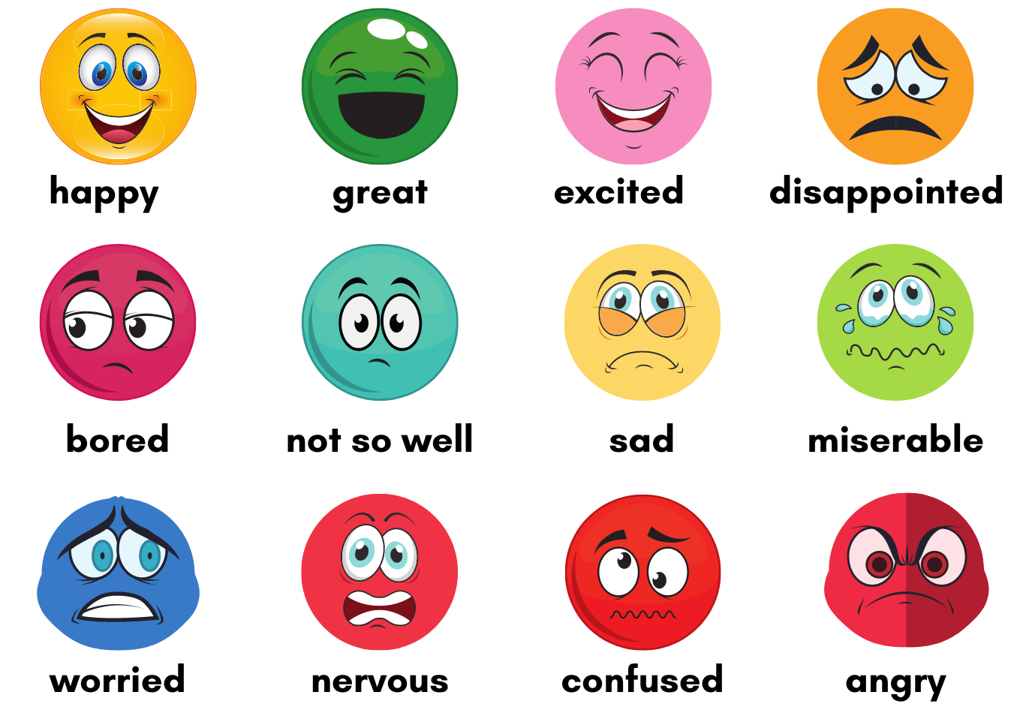
Let’s Speak !
How do you feel today?
Today, I feel…

Slide 5
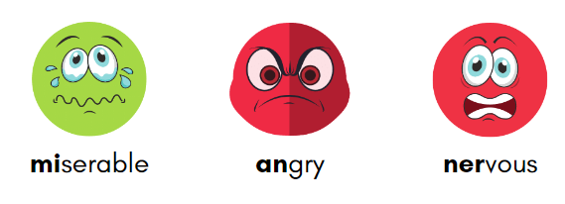
Pronunciation

Slide 6
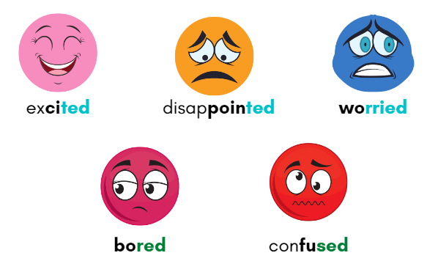
Pronunciation
[id]
[d]

Slide 7
Let’s play!

Slide 8
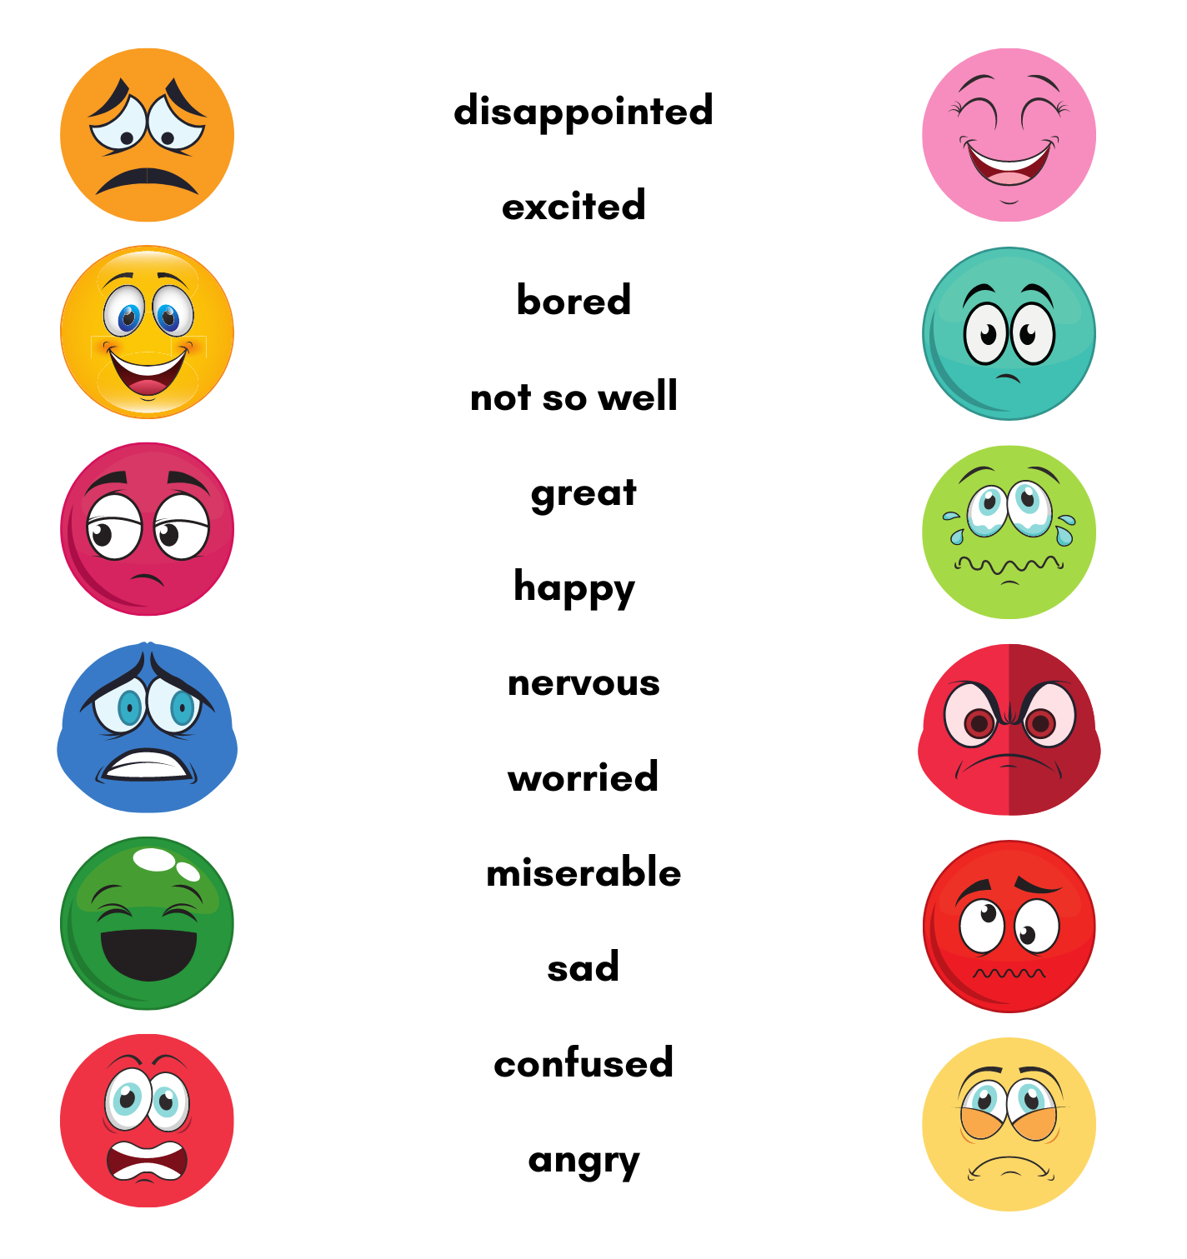

Slide 9
Let’s Listen!

Slide 10
Listen and find other adjectives !

Slide 11
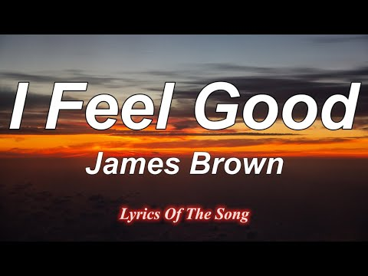

Slide 12
Let’s play!

Slide 13
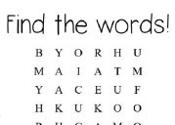
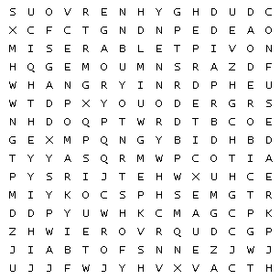
Find the words :
bored
disappointed
miserable
sad
confused
great
nervous
happy
excited
worried
angry

Slide 14
Let’s play!

Slide 15
plickers

