Slide 1
Unit 1 - Lesson 02
Objectif:
Savoir dire bonjour et se présenter.
Savoir dire comment on se sent.

Slide 2
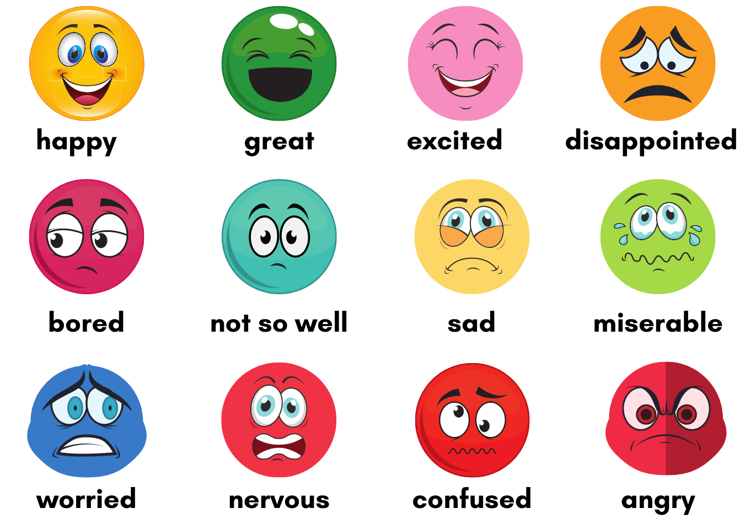
Let’s Speak !
How do you feel today?
Today, I feel…

Slide 3
Let’s play!

Slide 4
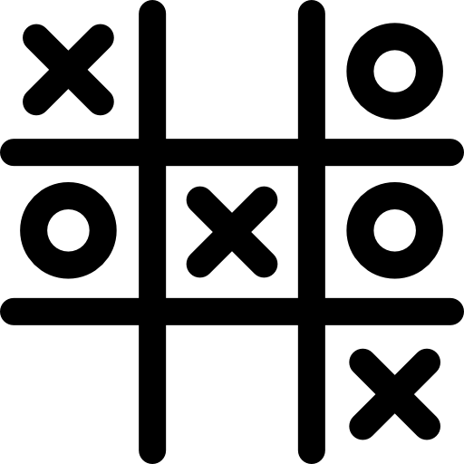
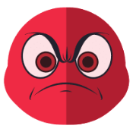

Slide 5
Let’s Speak !
What’s your name?
My name is …

Slide 6
Let’s Speak !
How old are you?
I’m 12 13 14 15 16

Slide 7
Let’s Listen!

Slide 8
Listen and find other expressions!

Slide 9
Pronunciation
Hi !

Slide 10
Pronunciation
Hello !

Slide 11
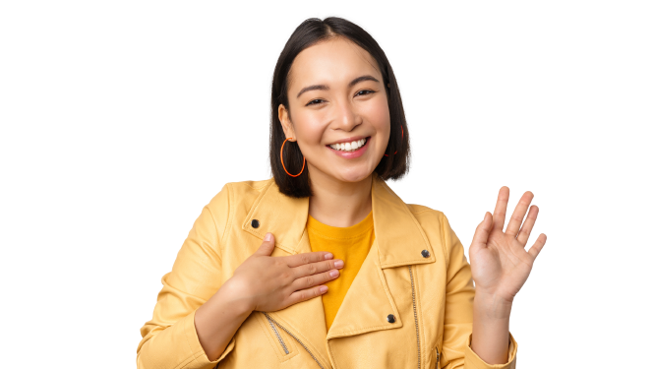
Pronunciation
Hello,
my name is Emma !

Slide 12
Pronunciation
Hi, I’m Jack !

Slide 13
Practise speaking!
Hello,
my name is Emma !
Hi, I’m Jack !

Slide 14
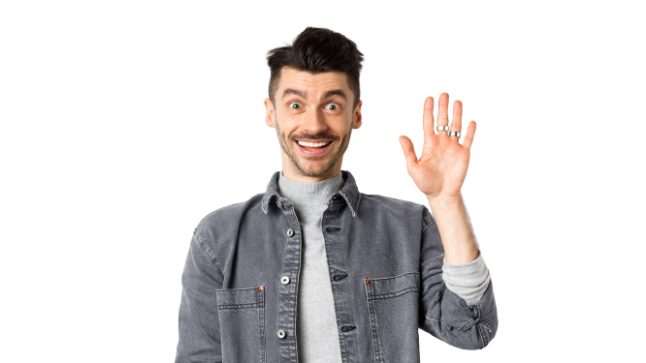
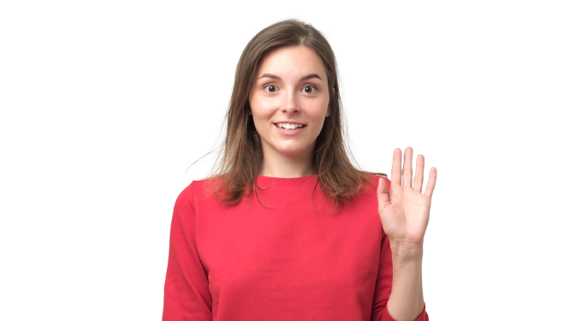
Practise speaking!
…
…
Max
Mary

Slide 15
Practise speaking!
…
…
Alice
Greg

Slide 16
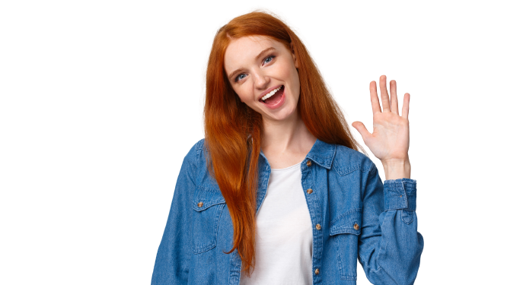
Practise speaking!
Megan
…

Slide 17
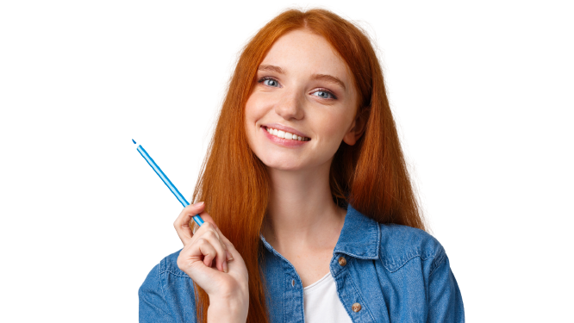
Practise speaking!
Today I feel…

Slide 18
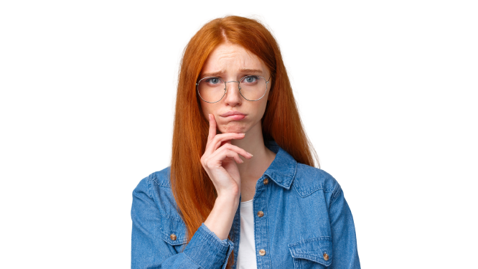
Practise speaking!
Today I’m …

Slide 19
Practise speaking!
Today, …

Slide 20
Let’s Speak !
Kim
…

Slide 21
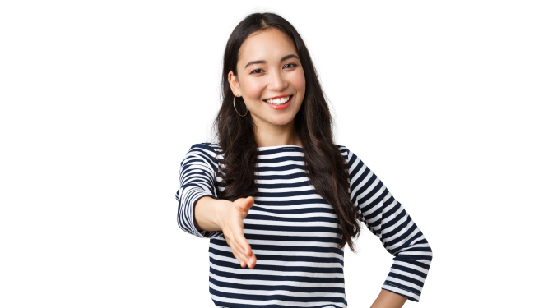
Let’s Speak !
Kim
…

Slide 22
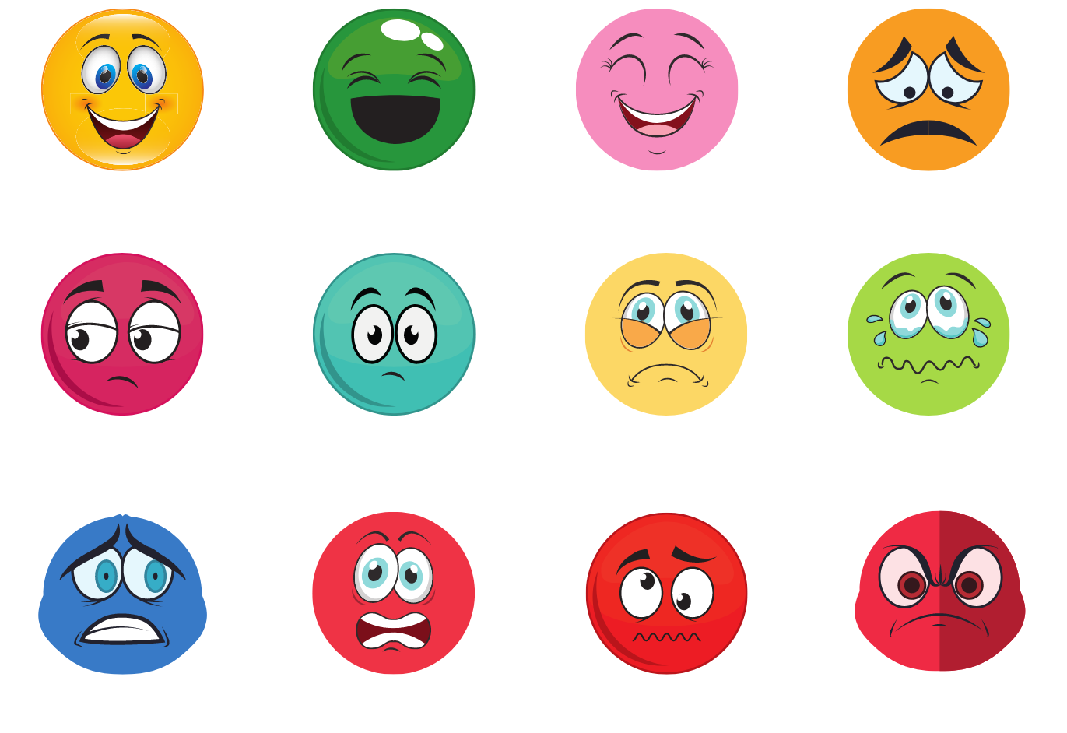
Practise speaking!
Today I’m …

Slide 23
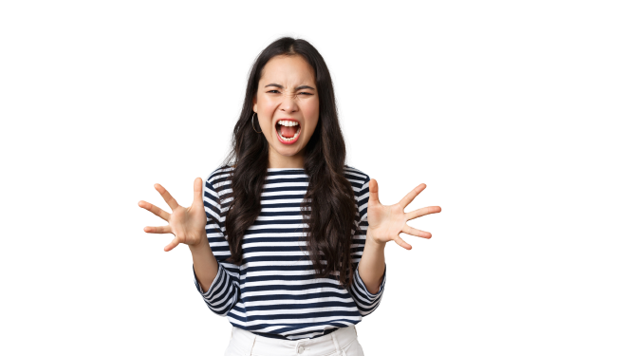
Practise speaking!
Today, …

Slide 24
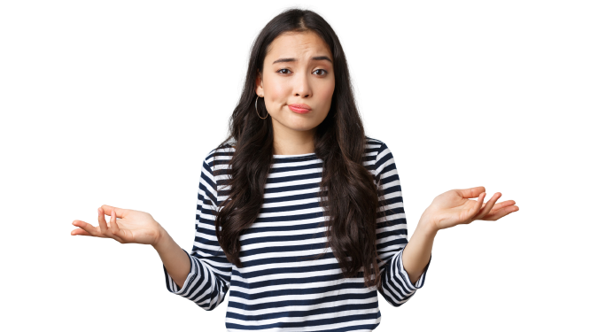
Practise speaking!
Today, …

Slide 25
Practise speaking!
Today, …

Slide 26
Let’s play!

Slide 27
Hello!
What’s your name ?
How do you feel today ?

Slide 28
Hi !
What’s your name ?
How are you ?

Slide 29
Let’s recap!
Hello, I’m Max!
What’s your name?
How are you?
Max
kim

Slide 30
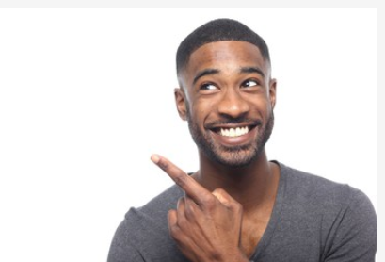
Mystery word !
But du jeu : trouver le prénom du personnage
Complète les questions suivantes:
 |  |  |  | ’ | s |  |  |  |  |  |  | n | a | m | e | ?
 |  |  |  |  |  |  |  | y | o | u | ?

